Slide 1
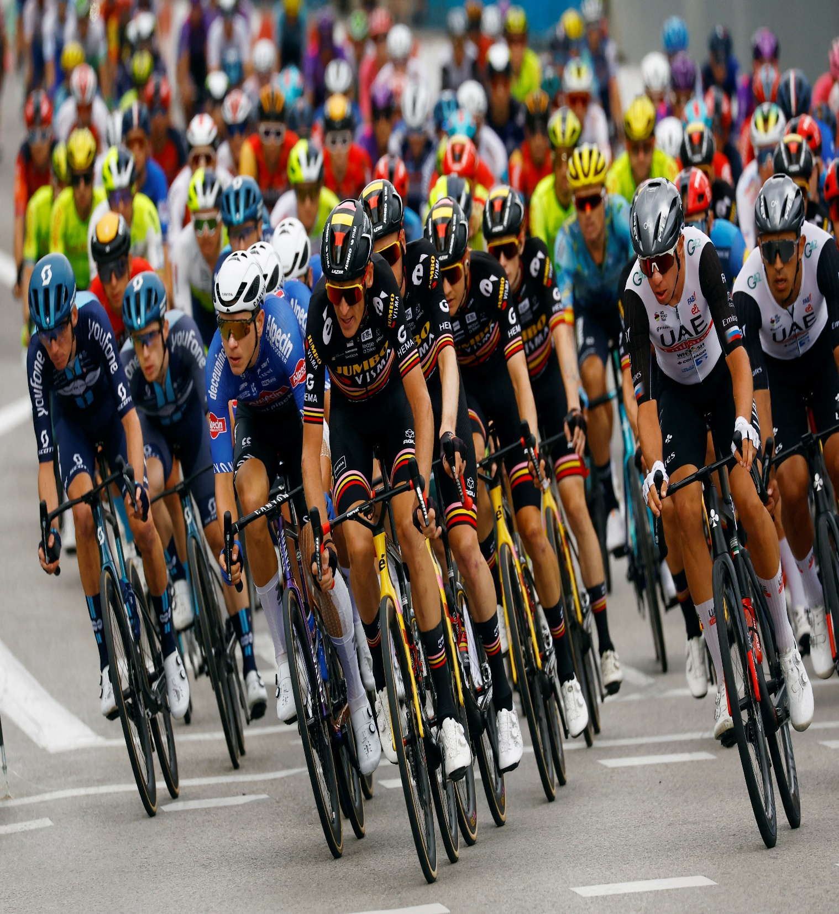
Bike Share Analysis
Case study by bipin kumar
29 July 2024

Slide 2
Agenda
Problem Statement
Data Analysis
Key Findings
Recommendations
Conclusion

Slide 3
Problem Statement
To analyze last 12 years of bike sharing data to find out the difference between the usage patterns of casual users and subscribed members.

Slide 4

DATA ANALYSIS
Analyzed all 12 months of data for uniformity.
Manipulated Data using Python pandas library.
Visualize data using Microsoft Power BI.

Slide 5
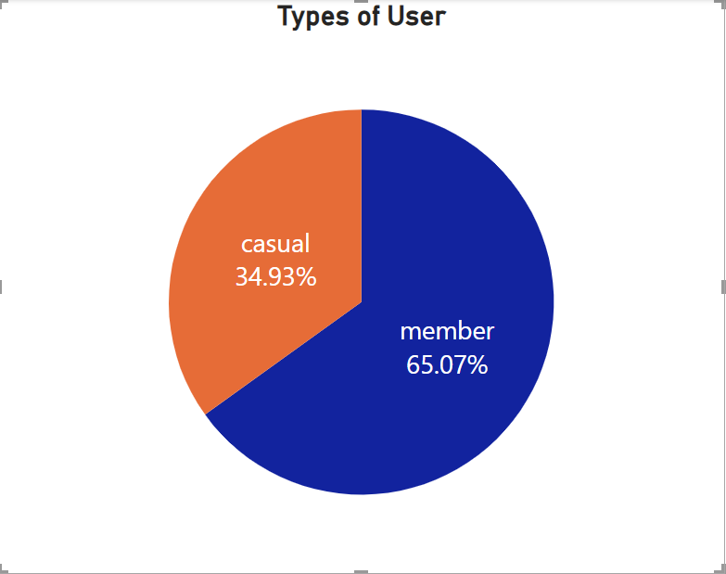
Key Findings
Out of total rides taken, only about 34% rides were taken by casual users.

Slide 6
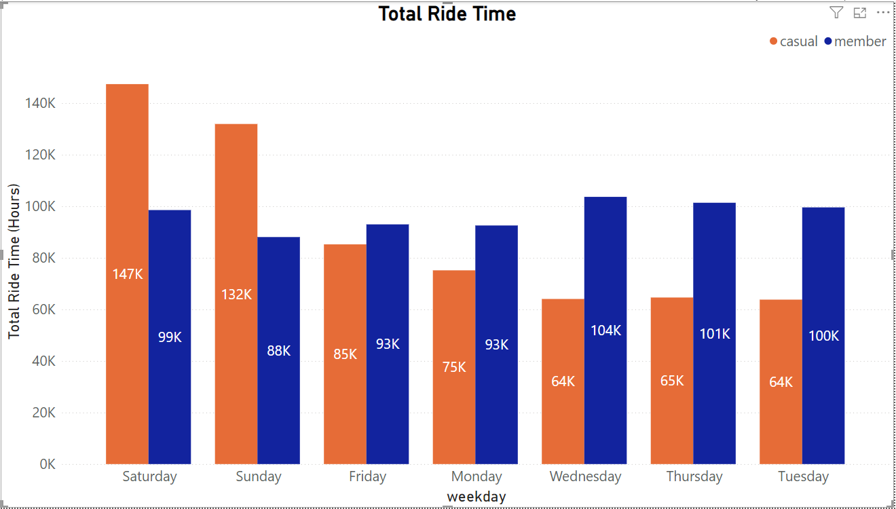
Key Findings
Casual users increase almost by 100% on weekend days.
Casual users do not prefer much to share bike on weekdays.
Member Users are more uniform throughout the week.

Slide 7
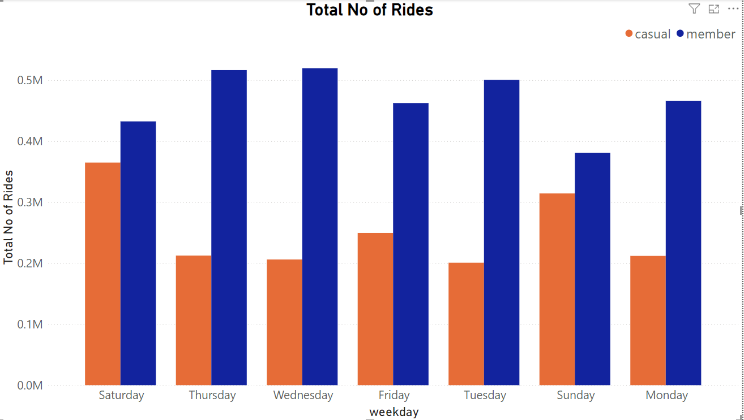
Key Findings
Number of rides for members are way higher than casual users, except for weekends but even there gap exists.

Slide 8
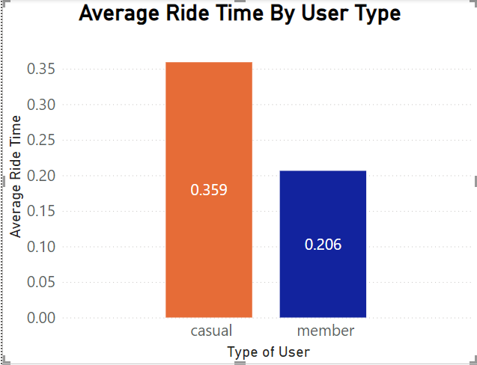
Key Findings
Total time on rides for casual users on weekend days is more even then they take less number of rides.
This is because they prefer long routes on weekends.

Slide 9
Recommendations
Can come up with weekend only membership plan with limited usage for weekdays.
This will address customers who prefer to use bike on weekends for long trips.
This will also make our memberships fees more affordable.

Slide 10
Recommendations
Can revisit pricing policies to reduce pricing for short trips.
This will address customers who avoid short trips because it charge more to non members.

Slide 11
Conclusion
Analyzed bike sharing data.
Identified difference in usage patterns of members and non members.
Recommended for the best possible solution forward to attract non members to purchase membership.

Slide 12
Thank you
ANY Questions?

